Slide 1

Resources: Planning and Debugging Code
Dr. Greg Erhardt
greg.erhardt@uky.edu E 599

Slide 2
Today’s Topics
Software Development Stages
Big-Design Up-Front and Agile Project Management
Debugging Strategies

Slide 3
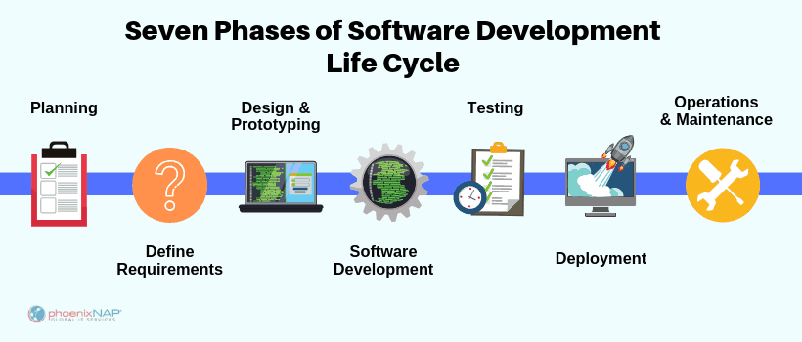
https://phoenixnap.com/blog/software-development-life-cycle

Slide 4
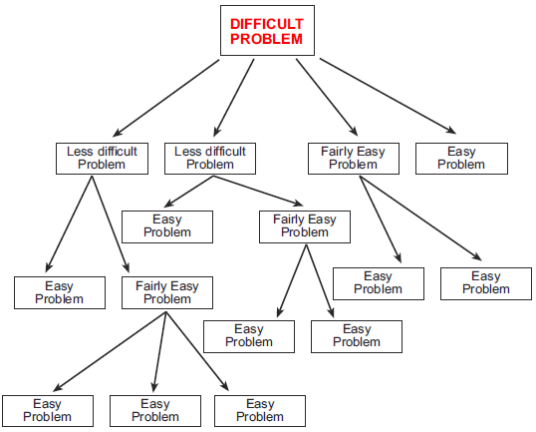
Top-Down Design

Slide 5
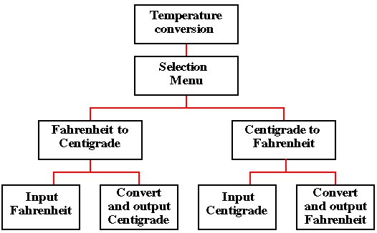
Top-Down Design

Slide 6
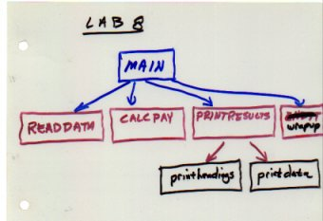
Top-Down Design

Slide 7
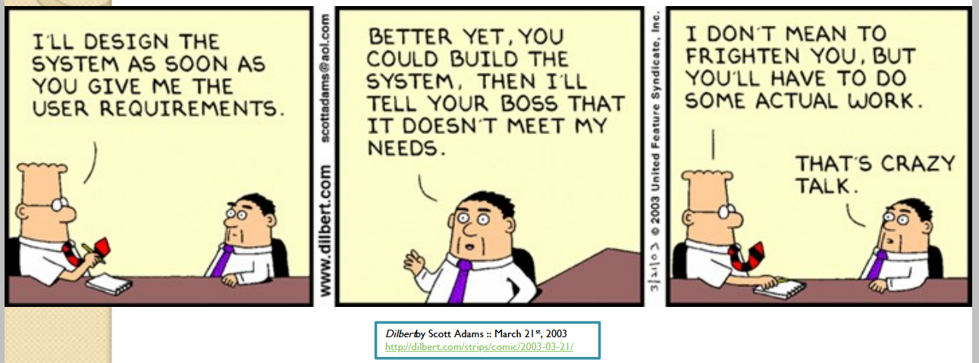

Slide 8
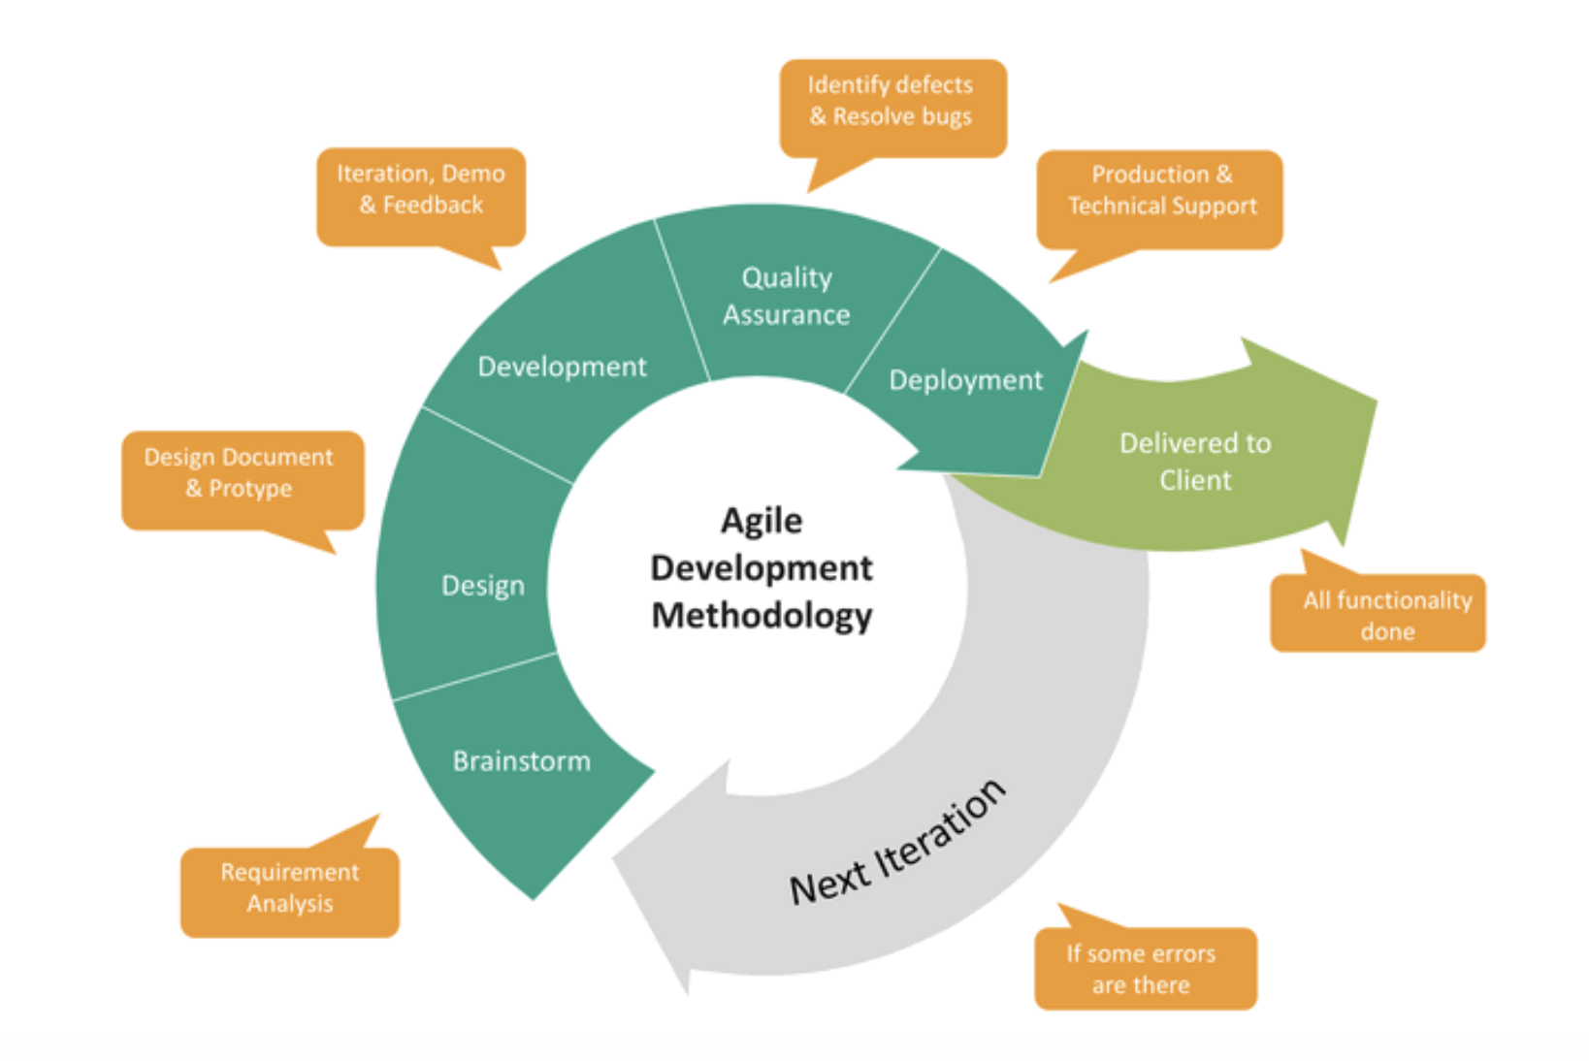
Agile Development

Slide 9
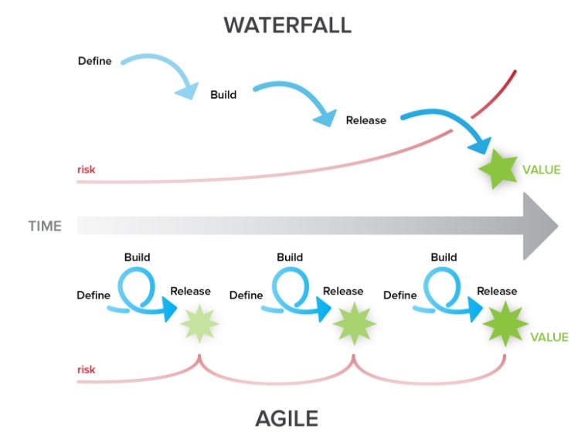
Agile Development

Slide 10
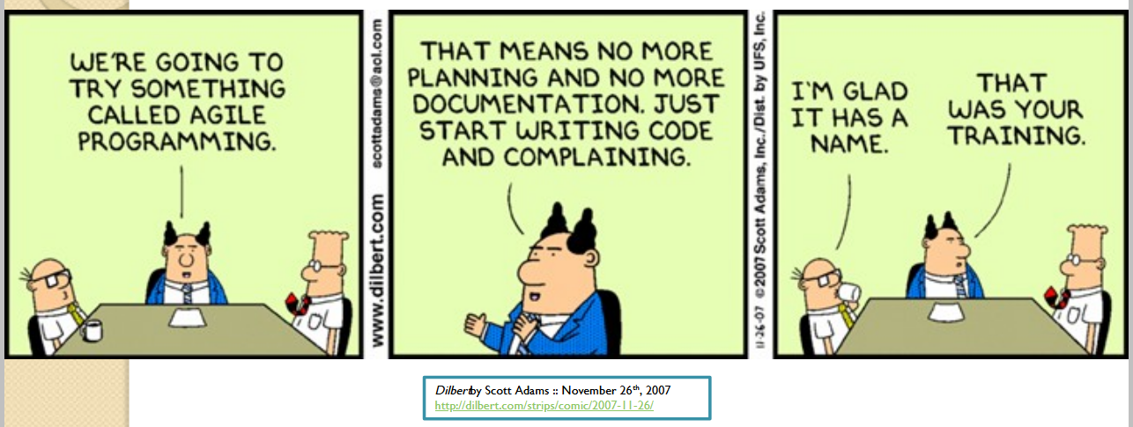

Slide 11
Debugging
How to debug small programs
https://ericlippert.com/2014/03/05/how-to-debug-small-programs/
Use Rubber Duck Debugging!

Slide 12
Debugging
How to ask for help
https://stackoverflow.com/help/mcve
Create a Minimal, Complete, and Verifiable example!

Slide 13
Debugging
How to get help
Explain it to a rubber duck
Google it
Ask a peer
Ask the professor
Ask StackOverflow

Slide 14
Debugging
Using Stack Exchange
https://stackoverflow.com/questions/20002503/why-does-a-b-or-c-or-d-always-evaluate-to-true
Your example…

Slide 15
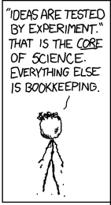
Debugging
But how do you know if the random answers you get on the internet are right?
Test them!

